Slide 1
Shushanth B S
Bachelor of Technology
Artificial intelligence and Data Science
211521243150
3/21/2024 Annual Review

Slide 2
PROJECT TITLE
Transformers Chatbot: Leveraging OpenAI Embeddings for Efficient Question Answering and Conversational Retrieval
3/21/2024 Annual Review

Slide 3


AGENDA
​Introduction
Project Overview
Implementation Details
Additional Processes
Demonstration
Conclusion & Discussion
3/21/2024 Annual Review

Slide 4

PROBLEM STATEMENT
​In today's digital age, the need for efficient and effective communication channels between humans and machines has become increasingly important. Traditional interfaces like websites and applications often require users to navigate complex menus or forms, leading to frustration and inefficiency. Additionally, accessing information buried in large documents such as research papers or manuals can be time-consuming and tedious.
To address these challenges, we aim to develop an intelligent chatbot capable of understanding natural language queries and providing relevant responses in real-time. This chatbot will serve as a conversational interface for users to interact with, simplifying the process of accessing information and performing tasks.
3/21/2024 Annual Review

Slide 5

PROJECT OVERVIEW
Our project involves developing an intelligent chatbot capable of understanding natural language queries and providing real-time responses. Key features include:
Natural Language Understanding
Real-Time Response
Adaptive Learning
Additional Processes for enhanced user experience.
The chatbot targets students, professionals, and general users, offering an intuitive interface for accessing information and performing tasks efficiently.
3/21/2024 Annual Review

Slide 6

WHO ARE THE END USERS?
Students: Students seeking information from academic papers, textbooks, or online resources for research, assignments, or studying purposes.
Professionals: Professionals in various fields who require quick access to documentation, manuals, support resources, or information relevant to their work tasks.
General Users: Individuals interested in exploring topics, getting answers to questions, or engaging in casual conversation with the chatbot for entertainment or informational purposes.
​
3/21/2024 Annual Review

Slide 7

YOUR SOLUTION AND ITS VALUE PROPOSITION
Our chatbot provides instant, accurate responses to user queries using natural language understanding. It offers:
Efficiency: Streamlines information access.
Convenience: Available anytime, anywhere.
Personalization: Adapts to user preferences.
Productivity: Enhances task efficiency.
Accessibility: User-friendly interface for all.
3/21/2024 Annual Review

Slide 8

THE WOW IN YOUR SOLUTION
Our chatbot isn't just another automated responder. It's a dynamic conversational partner powered by cutting-edge natural language understanding.
With lightning-fast response times and personalized interactions, it's like having a knowledgeable assistant at your fingertips, ready to help you navigate the complexities of information retrieval effortlessly. Whether you're a student, a professional, or just curious, our chatbot is here to revolutionize the way you engage with information, making every interaction a seamless and satisfying experience.
3/21/2024 Annual Review

Slide 9
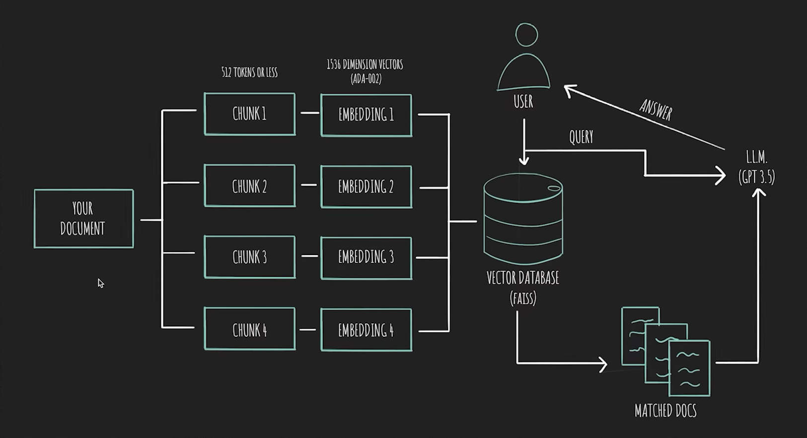
MODELLING
Teams cam add wireframes
3/21/2024 Annual Review

Slide 10
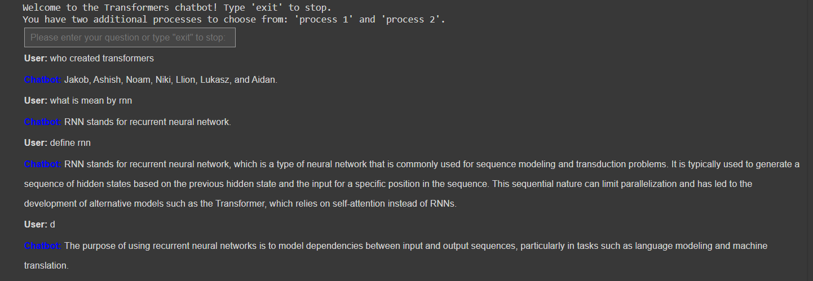
RESULTS
Demo Link
3/21/2024 Annual Review

